Slide 1
17-612 Fall 2023
Business & Marketing Strategy
Class 2
Jim Berardone
Associate Professor of the Practice of Product Management

Slide 2
Today’s Class
Learn about business cases for new product ideas
Know key financial concepts used to understand a company’s health

Slide 3
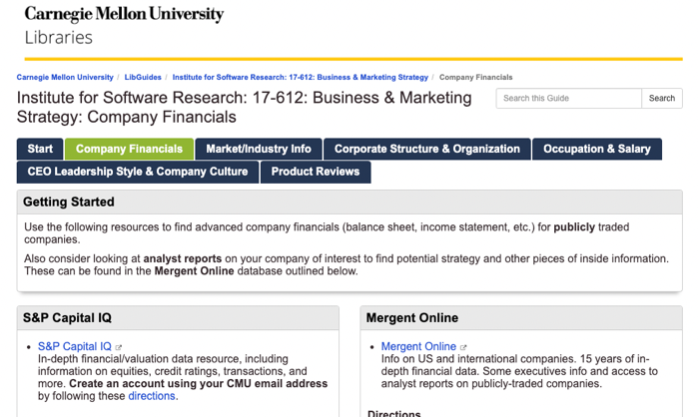
I’ll ask you to find a company’s financials information using either one of the 2 financial reporting sources.
on the Course Library page:
https://guides.library.cmu.edu/17-612/Company_Financials

Slide 4
Business case
A justification for a non-trivial investment to move forward with an idea
Used to justify developing new and improved products, systems, tools, infrastructure, equipment, etc.
How much investment is needed? money, people, assets
Is it a good investment for us?
i.e., is it worthwhile to pursue this idea? to continue pursuing it?
Is it a good fit for us?
Do the potential rewards exceed the potential risks?
i.e., risk is the degree of uncertainty and/or potential loss

Slide 5
Is it a good fit for us?
Fits the company mission, values, vision, goals and strategy
The company has the capabilities and competencies to do it.
There’s enough support for the idea to overcome internal resistance, inertia.

Slide 6

Is it a good investment for us?
costs
benefits
There are frequently competing ideas for investment.
Choose the ones that will get the best results
Image source: http://www.clipart-library.com
Notes:
Image source: www.nicepng.com

Slide 7
There are 2 kinds of benefits
Quantitative (a.k.a. tangible or hard benefits)
Projected revenue, costs, savings, productivity, etc.
Qualitative (a.k.a. intangible or soft benefits)
Fits the company mission, values, vision, goals and strategy
Expected competitive advantage, customer satisfaction, reputation
Business case relies on defensible assumptions, logic, data and evidence

Slide 8
Benefits – Costs > 0
Revenue – Expenses > 0
If > 0, then Profit. (“Income”)
If < 0, then Loss.

Slide 9
Income Statements

Slide 10
Income Statements (a.k.a. Profit & Loss (P&L) statements)
Show a company’s financial performance over a period of time.
Summarizes across all of its products and services.
Revenue = the money generated from the sale of products and services
− Expenses = the money spent in order to generate revenue
= Net Income = Profit (or Loss), a.k.a. ”the bottom line”
These financial concepts are included in a business case for your ideas.

Slide 11
Income Statement structure
Revenue | Year 1 | Year 2 | Year 3 | Year …
Sales
Other
Total Revenue
Cost of Goods Sold
Gross Profit ($) / Gross Margin (%)
Operating Expenses
Sales and Marketing Expenses
Research & Development Expenses
General & Administrative Expenses
Total Operating Expenses
Operating Income ($) / Operating Margin (%)
Other Non-Operating Expenses
Taxes, Interest, Depreciation, Amortization, Other
Net Income ($) / Net Margin (%)

Slide 12
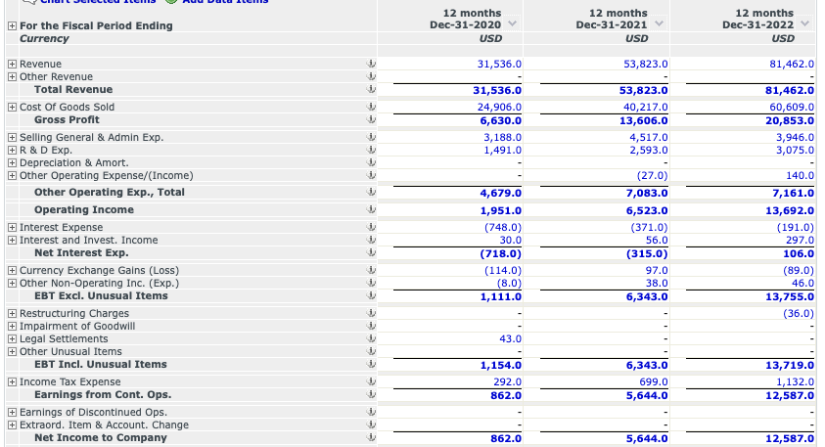
Example Income Statement: Tesla, Inc. (TSLA)
Source: https://www-capitaliq-com

Slide 13
Why you should learn to read Income Statements
Analyze a company’s financial health – is it getting better or worse? why?
Helps you to make a better business case.
Identify trends of how the company is investing in R&D, Sales and Marketing
Understand the impact of your product (idea) on the business
Helps with identifying goals for your product’s revenues and expenses
Understand how the company compares to the financial health of others
You’ll use the same financial concepts to create a business case for a product idea.

Slide 14
Revenue

Slide 15
If you were asked to calculate the total revenue of a university
for one year, which items would you include?

Slide 16
Total Revenue
The total inflow of money into your business earned in the time period.
Includes money from:
sales of your products and related services
royalties, asset sales, interest, etc.
Minus
returns of products and discounts

Slide 17
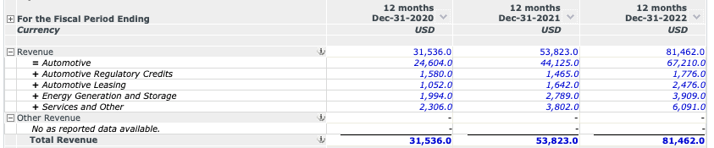
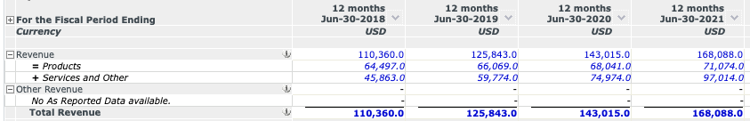
Example Revenues: Tesla (TSLA)
Companies may break down their total revenue by group of products or services, one per line (a.k.a. revenue streams)
Example Revenues: Microsoft (MSFT)
57%
Tot Rev
110% growth

Slide 18
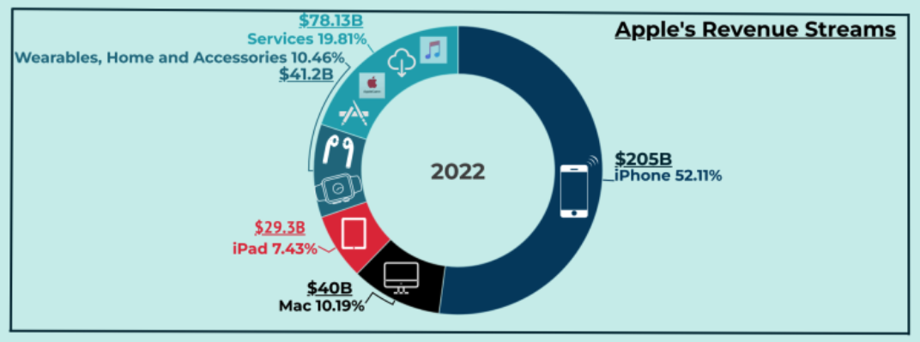
Sometimes, you can find research-based estimates of sales for product families or product lines
Inside a company, you would ask your finance dept or product leaders.
Source: https://fourweekmba.com/ June 5, 2023

Slide 19
Expenses (a.k.a. costs)

Slide 20
There are many expenses in doing business.
Payroll and payroll taxes
Employee benefits
Parts and components
Insurance
Electricity
Water
Telecommunications
Rent
Taxes
Office equipment
Advertising
Sales commissions
Licenses
Office supplies
Travel
Business entertainment
Interest on loans
Credit card fees
Equipment
Training
…many more

Slide 21
The expenses are categorized to help understand the health of the company
Cost of Goods Sold
The direct costs of producing or delivering the products or services that were sold.
Operating expenses
The indirect costs a company gs that don’t directly relate to the PRODUCTION or DELIVERY of a product or service.
General & Administrative expenses “overhead”
Selling and Marketing expenses
Research & Development expenses
Other (taxes, interest, inventory write-offs, depreciation, etc.)

Slide 22
Cost of Goods Sold (COGS) expense

Slide 23
Cost of Goods Sold (COGS) (a.k.a. Cost of Sales; Cost of Revenue; Cost of Service Provided)
The direct costs of producing the products or services that were sold in the time period.
Direct cost – an expense that can be traced to a specific product sold
Example: the raw material used in a product
Example: the time spent by an employee with a client to implement it
The COGS is a variable cost – it changes with the volume of sales
Indirect costs are not included
Management salaries, office space, utilities, insurance, office supplies
Sales and marketing, R&D

Slide 24


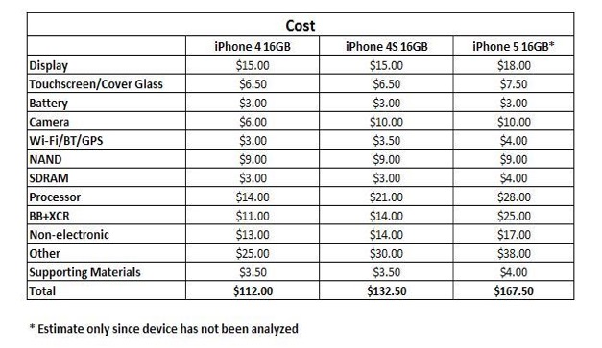
Example COGS: (old) iPhone (product’s COGS, not the entire company’s COGS)
FYI
iPhone 14 Pro Max costs about $501 each.
Price is $1099 each
Each iPhone sold has many parts.
Sum the cost to make each part (direct material + direct labor costs)
Plus, add the costs of parts purchased.
Source: www.techinsights.com
Notes:
Apple iphone = $501 COGS per unit. Sold base price of $1099
Source: www.techinsights.com

Slide 25
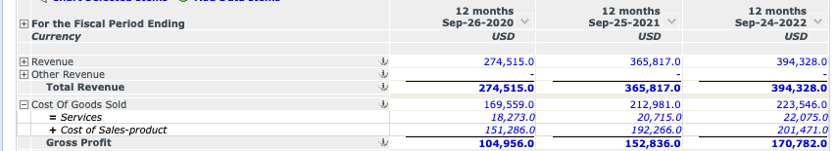
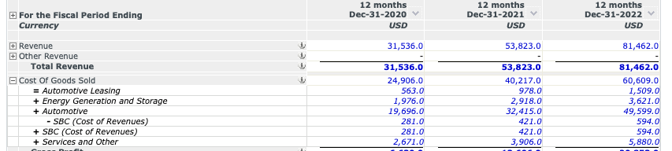
Example COGS – Apple Inc. (AAPL)
Example COGS – Tesla, Inc. (TSLA)

Slide 26
Discussion
Situation.
Your company has a SaaS data analytics app that is used by large businesses who pay $1M per year, on average.
It’s available as a Web app and as a native mobile app.
It’s stored, operated and delivered to users on AWS.
Identify the direct cost items that would be part of the COGS?
Think about the items that are necessary for the apps to work

Slide 27
Typical COGS items for a SaaS subscription
Hosting expenses – app hosting, monitoring, communications (e.g., AWS)
Infrastructure employees – to keep the production environment running e.g., DevOps
Fees for 3rd party software or data purchased that’s in your product
e.g., products that include Tableau for analytics/reporting
Employees directly involved in delivering the SaaS service
e.g., tech support, customer service, customer success, professional services

Slide 28
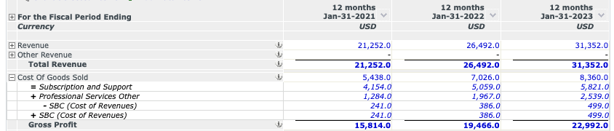
Example COGS: Salesforce, Inc. (CRM)

Slide 29
Examples of items in COGS (COS)
Reference
For SaaS products:
Infrastructure / hosting / DevOps costs
production environment
Customer success manager costs
Technical/customer support costs
Transaction costs (e.g., credit card fees)
Professional services costs (e.g., time spent integrating, implementing and training customers)
29% of sales revenue = Median of publicly-traded SaaS companies
For manufactured products:
Parts used in production.
Raw material costs
Labor to make the products
Storage costs
Technical/customer support costs
Customer success costs
Transaction costs
Professional services costs
In-bound freight costs
Typically, 50% - 65% of sales revenue

Slide 30
Gross Profit and Gross Profit Margin

Slide 31
Gross Profit
= Total Revenue minus Cost of Goods Sold
“After spending $____ on the cost of providing each product sold, how much remains?”
→ i.e., How much is left to apply to selling, marketing and administrative expenses?
If we need more money for Selling, Marketing and Administrative expenses (and profit)
selling more won’t help.
we need to become more efficient with each product sold.
If Gross Profit is declining this indicates
we’re getting less efficient or getting lower prices paid for our product.

Slide 32
Gross Profit and Gross Profit Margin
Revenue | Year 1 | Year 2 | Year 3 | Year 4
Sales
Other
Total Revenue
Cost of Goods Sold
Gross Profit
Gross Margin (%)
Gross Profit ($) = Total Revenue minus COGS
Gross Profit Margin (%) = (Gross Profit / Total Revenues) x 100
a.k.a. Gross Margin, GM

Slide 33
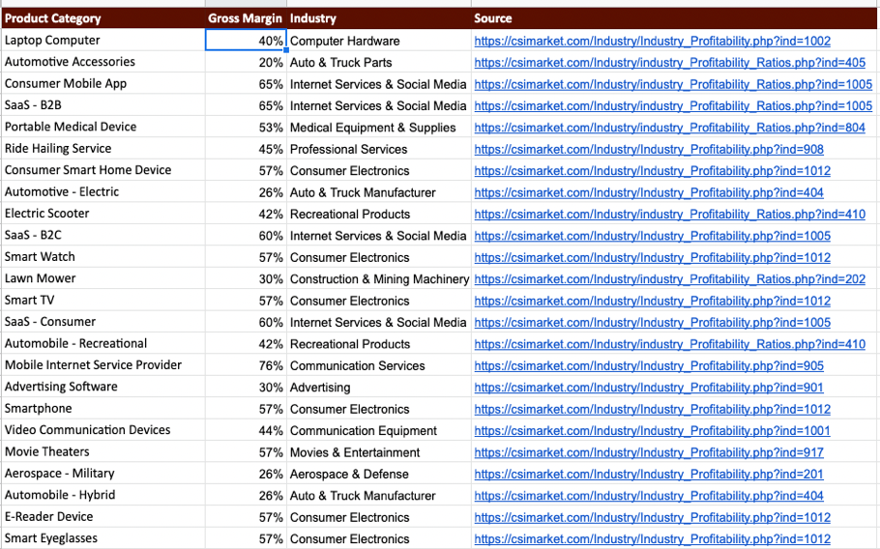
Gross Margins of several Product Categories
Why would SaaS B2B products have a higher Gross Margin than:
- Ride Hailing Service
- Laptop Computer
Why is Aerospace so low at 26%?

Slide 34
General & Administrative Expenses

Slide 35
General & Administrative Expenses (a.k.a. overhead)
Expenses incurred to run the business but unrelated to the products. They may benefit the company as a whole.
Compensation (salaries, wages, benefits, stock-based compensation (SBC), payroll taxes)
Managers, Execs, Human Resources Dept., Finance Dept., IT Dept., Legal Dept.
Product Managers, sometimes
Not including those in Sales, Marketing, Research and Development
Office space (rent)
Insurance
Office supplies
Travel
Utilities
…more

Slide 36
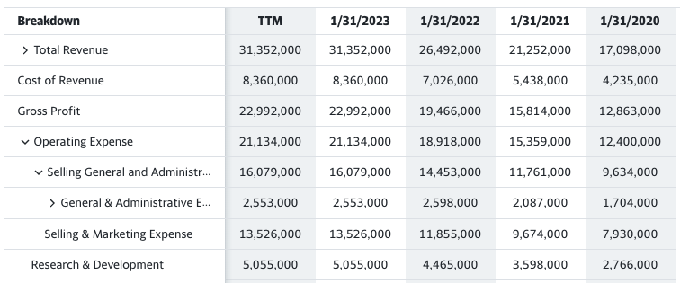
Example G&A Expenses: Salesforce (CRM)
FYI - Sometimes report G&A and Sales Expenses together as SG&A.
In their fiscal year ending 1/31/2023, Salesforce spent 8% of their revenue to pay for their G&A expenses.

Slide 37
When trying to improve profits, companies often start with reducing G&A expenses
Rather than…
Increasing price as it may lead to lost sales
Decreasing COGS by using lower cost materials, parts, and labor can lead to lost sales

Slide 38
Selling and Marketing Expenses

Slide 39
Selling and Marketing Expenses
Costs attributable to the selling, marketing, promotion of the product.
Sales and marketing compensation (salaries, commissions, benefits, SBC, and payroll taxes
field sales rep, inside sales rep, marketing rep,…
Advertising costs (ads, sponsorships, website, trade shows, etc.)
Travel expenses (directly related to selling and marketing of the products)
Sales and marketing automation tools
Packaging and distribution expenses
Sales office costs
…more

Slide 40
Example Selling and Marketing expense: Salesforce
In their fiscal year ending 1/31/ 2023, Salesforce spent 43% of total revenue on Selling and Marketing.
That’s 267% more than they spent of Research and Development of products.

Slide 41
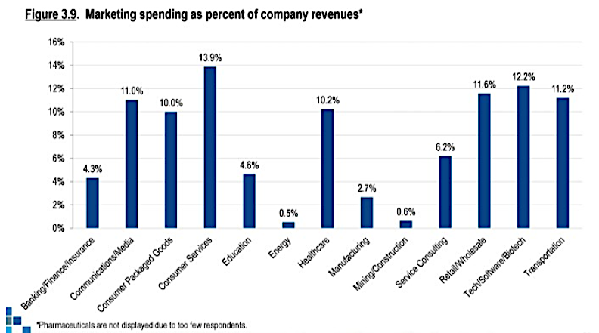
Source: https://www.marketing-interactive.com/which-industry-spends-most-on-marketing
Notes:
Source: https://www.marketing-interactive.com/which-industry-spends-most-on-marketing

Slide 42
Research & Development (R&D) Expenses

Slide 43
R&D Expenses
Costs directly incurred in developing or improving a product or service
The expenses to develop a product (a.k.a. Product Development expenses)
design, protoype, engineer, test, products, services, technologies or processes
Compensation
tech/engrg executives, engineers, designers and others who contribute to R&D
Fees for external contractors or consultants
Training
Travel
Infrastructure (for product development, not production)
Tools and equipment for product development (e.g., test automation software)

Slide 44
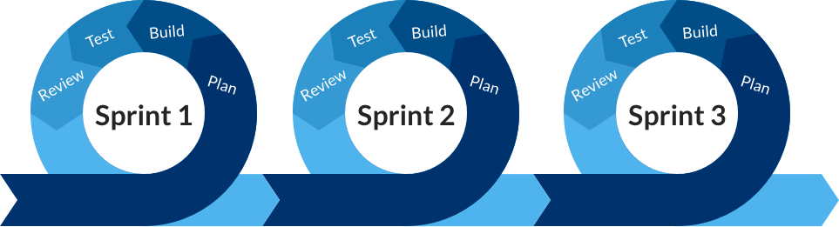
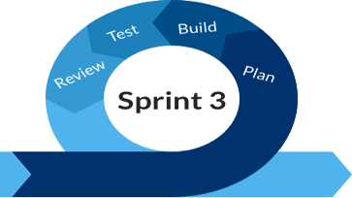
R&D Expenses occur over time
First product model
new product models
Physical products
Concept Dev.
Prototyping Dev.
Engineering
Production
Product Launch
Maintenance & Enhancement
First software version
new versions
Software products
Sprint 4
Launch

Slide 45
Example R&D expense: Salesforce
In their fiscal year ending 1/31/ 2023, Salesforce spent 16% of total revenue on R&D

Slide 46
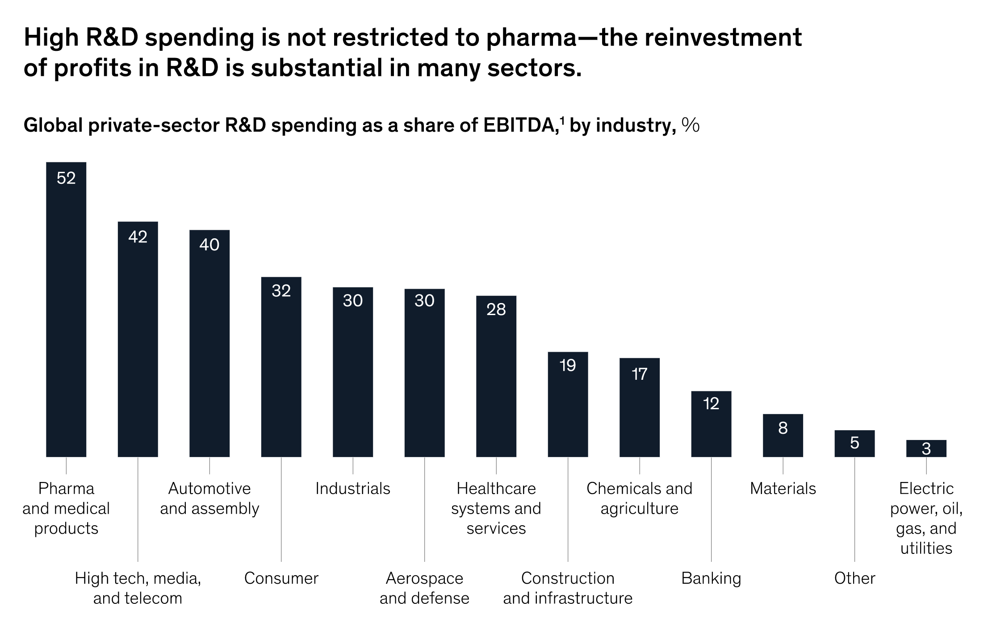
In 2019 by industry
Notes:
Source: McKinsey & Company

Slide 47
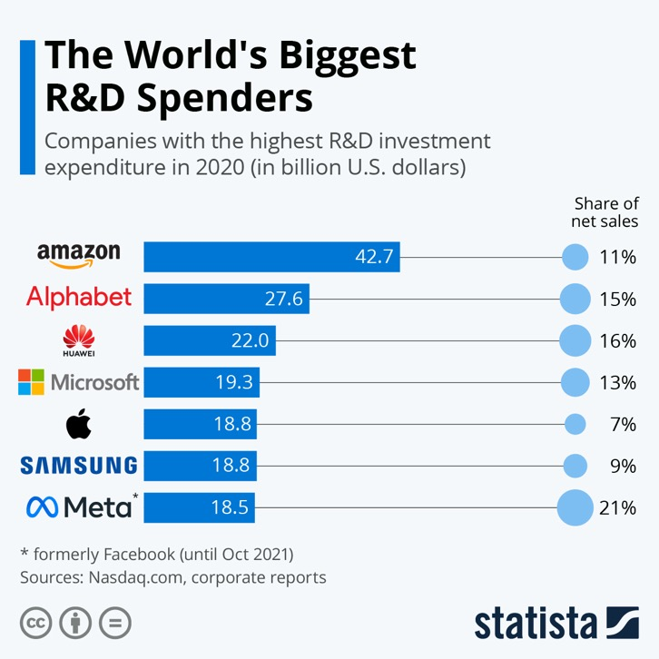

Slide 48
Exercise
Select a publicly-traded company
Find its income statement using one of the 2 resources on the Course Library page
OR from another source such as Yahoo! Finance or Wall Street Journal Online
For its most recently reported year, find
Sales and Marketing Expense
R&D Expense
Find or Calculate
1. S&M Expense as a Percentage of Revenue
2. R&D Expense as a Percentage of Revenue

Slide 49
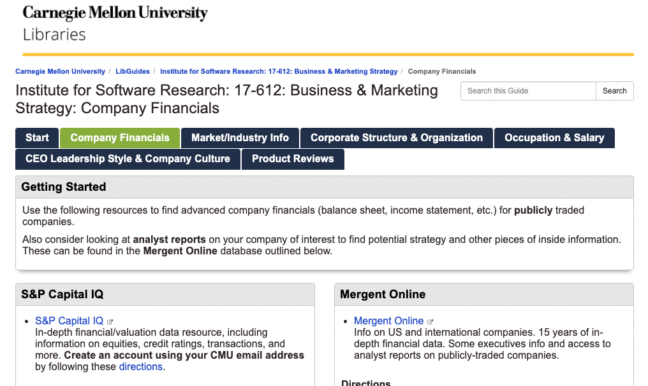
Use the Company Financials tab on the Course Library page
Select
S&P Capital IQ

Slide 50
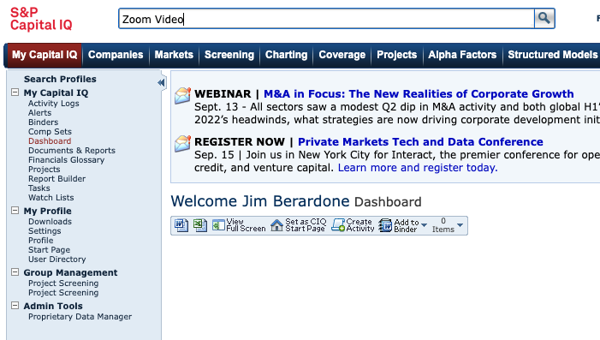
Search for your company name

Slide 51
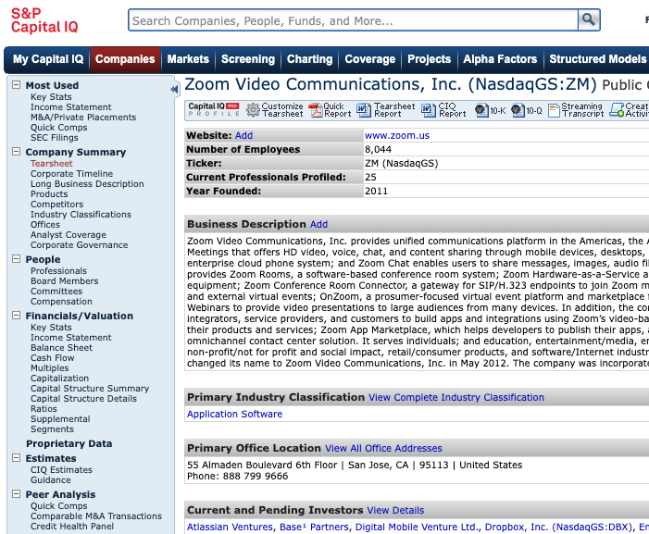
Select Income Statement
You could get to know Key Stats, Segments, and Ratios, too.
Look for CIQ Estimates for future revenue, profit, etc. estimates

Slide 52
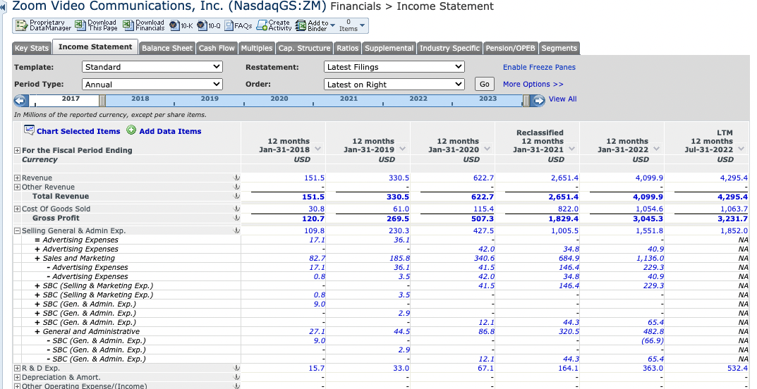

Slide 53
Net Profit and Net Profit Margin
Net Profit – it’s in monetary terms ($, EUR…) a.k.a. net income
The difference between gross profit and expenses in a time period.
or, total revenue minus all expenses.
Negative is a loss
Higher profit can be reinvested into growth through product innovation, acquisitions, etc.
Net Profit Margin – it’s a percentage (%)
Net Profit Margin (%) = (Net Profit / Total Revenues) x 100 → for a time period
How efficient are we at converting sales to profit?
It’s one gauge of company health.

Slide 54
End of Class 2

